Slide 1

CIS 5850
INDEED INSYNC:
Navigating IT Careers Dashboard
Submitted By:
Ankita Savaliya, Bhumika Suvagia, Dhwani Vaishnav, Manimozhi Neethinayagam

Slide 2
Introduction
Project Outline
Phases of Project
Challenges
Business Use Case
AGENDA

Slide 3
INTRODUCTION
We scraped Indeed.com for IT/Software jobs to gain industry insights and understand current employment trends.
Focusing on California, Florida, Texas, and other locations aimed to capture diverse job markets strategically.
Utilizing Python for web scraping and Tableau for visualization, we aimed to create a user-friendly dashboard for insights into the dynamic IT job landscape.
Including roles from Database Administrators to Machine Learning Engineers aimed to present a comprehensive industry snapshot.
Storing data in CSV format enabled seamless analysis, empowering our team to uncover patterns and trends in IT and Software opportunities.
This project was driven by curiosity to decode job market nuances, providing actionable intelligence for job seekers and industry stakeholders.

Slide 4
PROJECT OVERVIEW
Choose a programming language – Python
Data Cleaning
Standardizing and Normalizing Data
Data Visualization
Connect Clean data to Tableau
Web Scrapping
Install necessary libraries: Selenium, Web driver
Inspect the website and Send an HTTP request
Parse the HTML
Handle pagination and dynamic content
Extract Data
Store the data - CSV
Handling Inconsistent Formats
Handling Missing Values
Handling Categorical Data
Choose Visualization Type
Create Dashboard
Add Interactivity and KPIs

Slide 5
01
02
Project Planning
Web Scrapping
Define Objectives
Scope Definition
Tools and Technology
Define Timeline
Define Scraping Strategy
Data Formatting
Data Parsing
Data Structuring
PHASES
OF THE
PROJECT
03
04
Data Cleaning
Data Analytics & Visualization
Data Quality Check
Standardization
Analysis & Find Insights
Tool Selection
Design
Functionality

Slide 6
WEB SCRAPPING: EXTRACTING DATA WITH PYTHON
01
02
03
Web Scraping Objective
Key Code Features
Data Extraction and Cleaning
Leverage Selenium for web scraping of IT/software jobs on Indeed.com.
Use Pandas for data manipulation and analysis.
Save results to a CSV file for further insights.
ChromeDriver Configuration:
Specify executable path and maximize browser window for visibility.
Web Scraping with Selenium:
Extract job data from Indeed.com using ChromeDriver and handle cookies.
Read job inputs from an Excel file and dynamically interact with search elements.
Add random delays for human-like behavior and to avoid detection.
Use Pandas to read and structure job input data.
Define functions for extracting and cleaning job data.

Slide 7
WEB SCRAPPING: EXTRACTING DATA WITH PYTHON
04
05
06
Searching Jobs
Extracting Job Details
Multithreading for Efficiency
Navigate to Indeed.com and perform job searches dynamically.
Define functions for extracting job details (company, location, date, salary, experience, job type).
Use regular expressions for extracting salary and experience information.
Implement multithreading for concurrent job searches.
Define a function for scraping jobs for a given filter.
Utilize ThreadPoolExecutor to manage multiple threads.
07
Result Processing
Create DataFrames from the extracted job data.
Concatenate DataFrames horizontally.
Save the final result to a CSV file named 'indeedJobs.csv'.

Slide 8
Data Cleaning Assumptions
Salary Column:
Converted all metrics to annual based on different patterns for data consistency.
Hourly rates converted to annual salary using a standard 40-hour workweek and 52 weeks per year.
Job Mode:
Extracts job modes from the ‘Job Location' column based on keywords like 'Remote,' 'Hybrid,' and 'In-person.'
If no specific job mode is identified, the script defaults to 'In-person.’
Job Category:
Defined rules for categorizing job types based on patterns found in the 'Job Type' column

Slide 9
Data Cleaning
Job Location
Work Mode (Remote/Hybrid)
Create a new column for "Work Mode" (Remote/Hybrid/In-Person) based on job location information.
Experience Column
Keep only numerical values in the Experience column, eliminating any accompanying text and symbols. Replace empty spaces with "Not Available."
Split the existing unified Location Column into distinct columns for City, State, and Zip.

Slide 10

Data Cleaning
Maintained two columns: Minimum and Maximum Annual Salary.
Standardized all other metrics to annual salary, assuming full-time work (8 hours/day, 20 days/month, 12 months/year) for various job types.
Adjusted salary metrics with "From" or "Up to" wages, converting estimated ranges into distinct Minimum and Maximum Annual Salary values.
Replaced blank values in Minimum and Maximum Salary columns by calculating mean values within each location and job title grouping.
Excluded rows containing salary values within the Company Name field, accounting for approximately 0.1% of the total rows.
Salary

Slide 11
Data Cleaning
Job Type:
Group based on sub-divisions for concise categorization
Date Column:
Implemented a function to calculate the actual date based on the 'days ago' information.
Others:
Handled Null Values.
Generated 'Employer_Active_date' and 'Job_Posted_date' columns to store calculated dates.
Utilized functions for extracting and calculating dates based on identified patterns.
Converted the string Date types to Numeric based on the category and Groups.

Slide 12
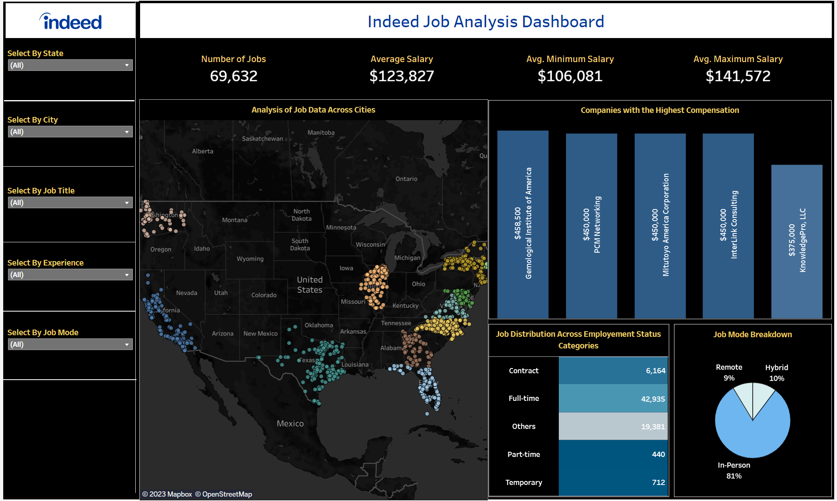
INTERACTIVE DASHBOARD
Tableau Public Link: https://public.tableau.com/views/Indeed_Job_Analysis/FinalDashboard?:language=en-US&publish=yes&:display_count=n&:origin=viz_share_link

Slide 13




Overcoming Challenges
BUSINESS USECASES OF INDEED IT JOB DASHBOARD
Strategic Shift from LinkedIn to Indeed.com
Began the project with LinkedIn web scraping, considering its stability in job data.
Limitation Discovery: LinkedIn restricts job retrieval to 999 within a browser session, and refreshing starts anew, preventing fetching more than 999 jobs for a Job Title + Location pair.
Challenges in Data Classification
Encountered diverse and unstructured job titles, complicating data organization.
For instance, searching "Project Manager in California" yielded titles like "Project Manager I" and "Assistant Project Manager," highlighting the complexity in categorization.
Execution Duration Concerns
Each search criterion consumed 2-3 hours, yielding 25 IT jobs across 50 states.
Identified bottlenecks in fetching data for all North America states, resulting in a substantial overall time investment of approx. 156 days!
Decision to optimize by reducing states to 11, still maintaining an execution time of 34 days!
Led to the strategic decision to introduce multithreading for efficiency.

Slide 14


BUSINESS USECASES OF INDEED IT JOB DASHBOARD
PERSONALISED JOB SEARCH
STRATEGIC SKILL DEVELOPMENT
TARGETED RESUME BUILDING
INDUSTRY TREND MONITORING
SALARY BENCHMARKING
JOB MARKET INSIGHTS

Slide 15

Thank you!
Follow us on GitHub!

